Slide 1

WEB SCRAPING of SHIKSHA Website using EDA

Slide 2

About Us
P. Sanjay Kumar
G. Praveen Raj
Qualification: M.Sc(Statistics)
Experience: AVOC Associate in Amazon
Duration: 6 months
Batch No: 191
Qualification: MBA
Experience: Associate Content analyst
Duration: 9 months
Batch No: 191

Slide 3

Table of Contents
Problem Statement
Process of Web Scraping
Creation of Data frame
Data cleaning
Data Visualization
Conclusion
Experience in the Project
Q&A
Objective
Architecture Data Collection

Slide 4
Objective of the Project
Finding the colleges based on students requirements.

Slide 5

Problem Statement
Based on NIRF RANK
Based on fee and salary
Placements offered
Faculty and value for money
Campus and Infrastructure
Overall rating

Slide 6


Process of Web Scraping
Find the URL that you want to Scrape
Inspect the Page
Find the data you want to Extract
Write the Code
Run the code and extract the data
Store the data in the required format

Slide 7








Web Scraping used tools
Beautiful soup & requests are the tools used for the Web Scraping
Web scraping Tools
Data Cleaning
& Manipulating
Data visualization

Slide 8
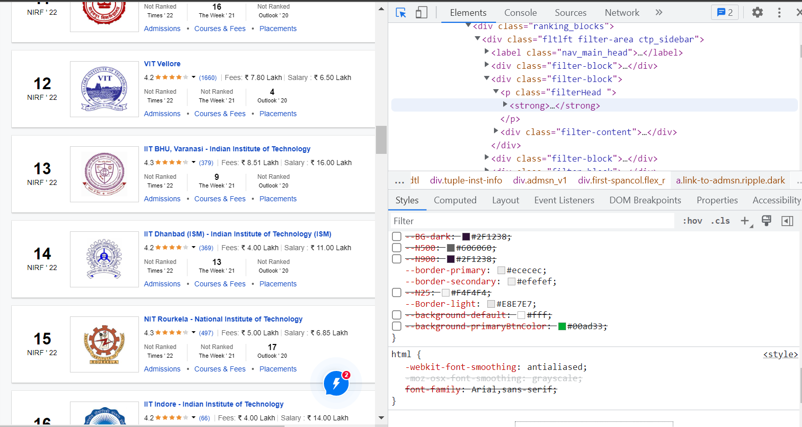
Shiksha Website

Slide 9
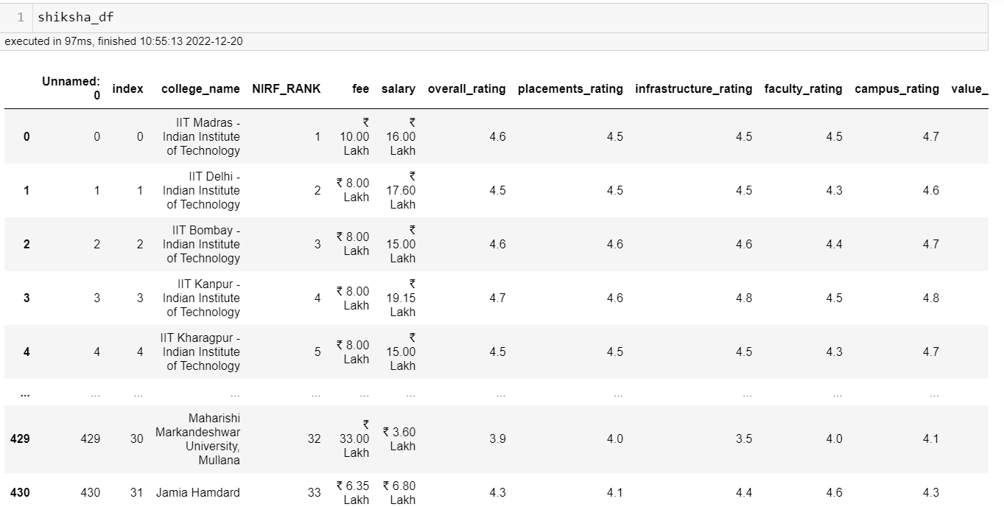
Data Cleaning
Before Cleaning

Slide 10
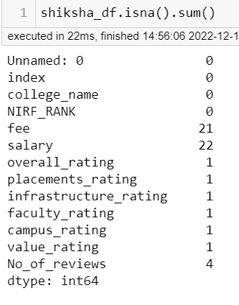
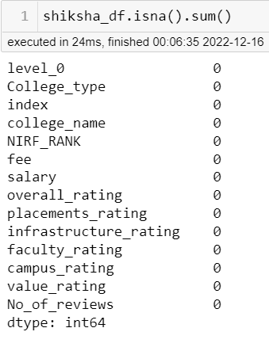
Creation of Data Frame Observe the Missing Values
After
Before

Slide 11
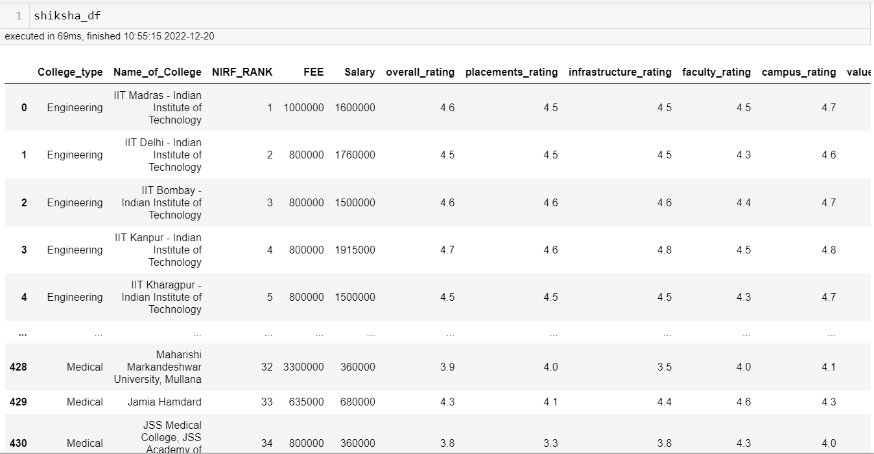
After Cleaning

Slide 12

There are three types of data analysis:
Univariate analysis:
Univariate analysis means taking single variable for the analysis either it may be Categorical or Numerical.
Bivariate analysis:
Bivariate analysis means taking two variables for the analysis either it may be Categorical or Numerical.
Multivariate analysis:
Multivariate analysis means taking more than two variables for the analysis either it may be Categorical or Numerical.
Univariate data requires to analyze each variable separately.
Bivariate analysis refers to the analysis to determine relationships between them.
Multivariate analysis determines relationships, dependence between them.
Data Analysis

Slide 13
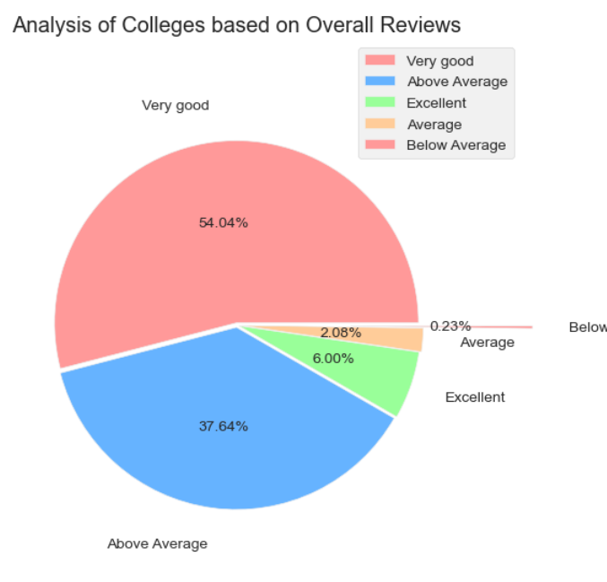
Univariate analysis
Observation :
The Pie chat explains about the sharing of Based on reviews.
The major part are falling in the Very good category followed by Above Average

Slide 14
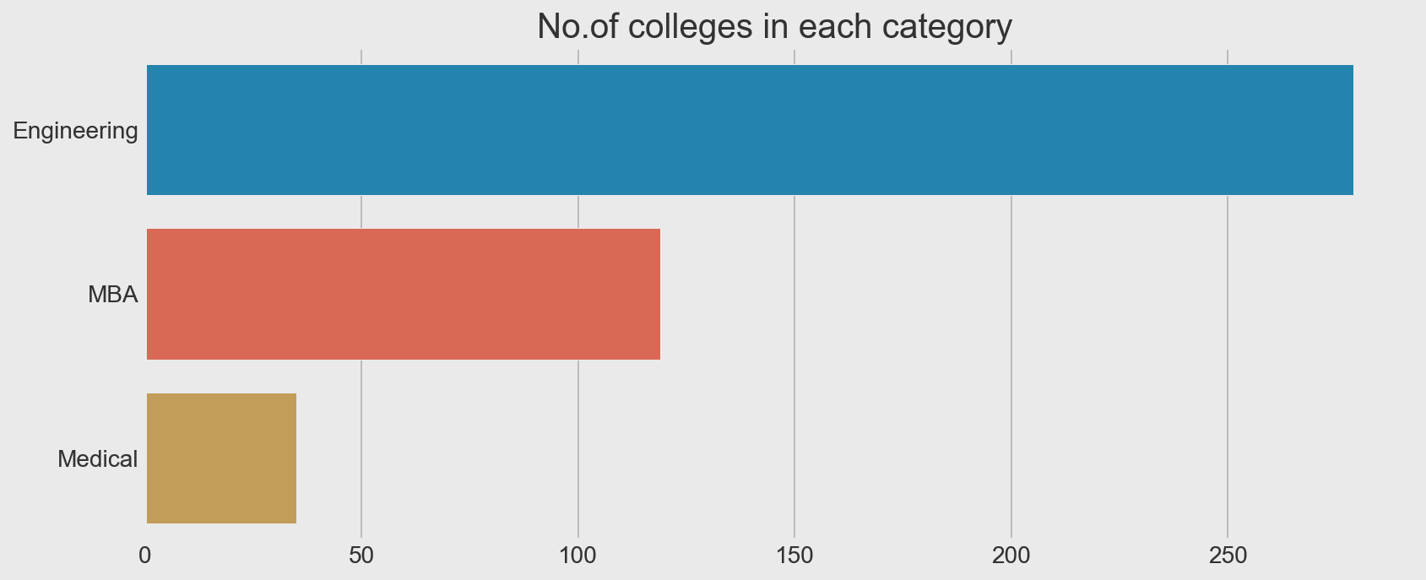
Observation:
It shows about the count of each college type in overall DataFrame.
By above Barchart we can say we have more Engineering colleges in our DataFrame compared to MBA and Medical colleges.

Slide 15
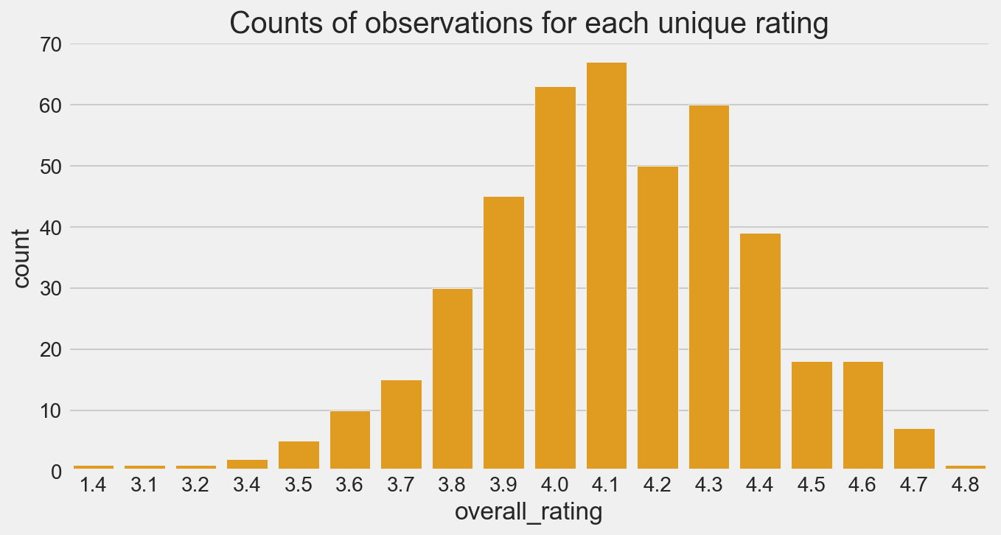
Observation:
The countplot is about the how many colleges are falling under each unique ratings.
By above countplot we can say maximum colleges are having the ratings between 3.9 t0 4.4 in our dataframe.

Slide 16
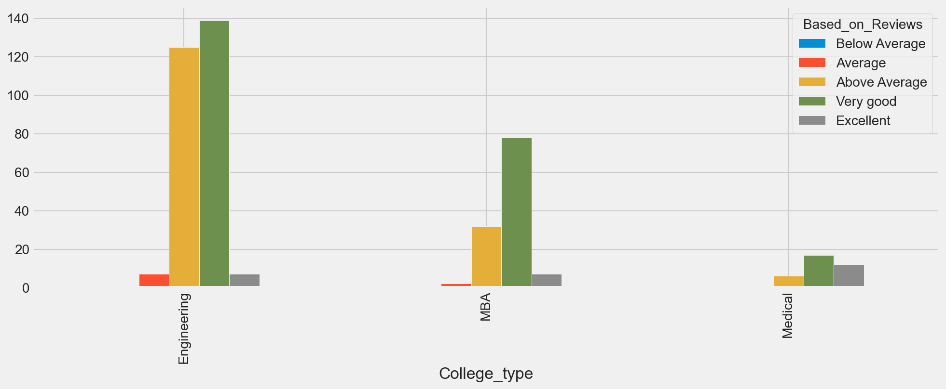
Bivariate Analysis
Observation:
Counting of each college type based on Reviews
From above we can say in each category of college type we have more Very good colleges

Slide 17
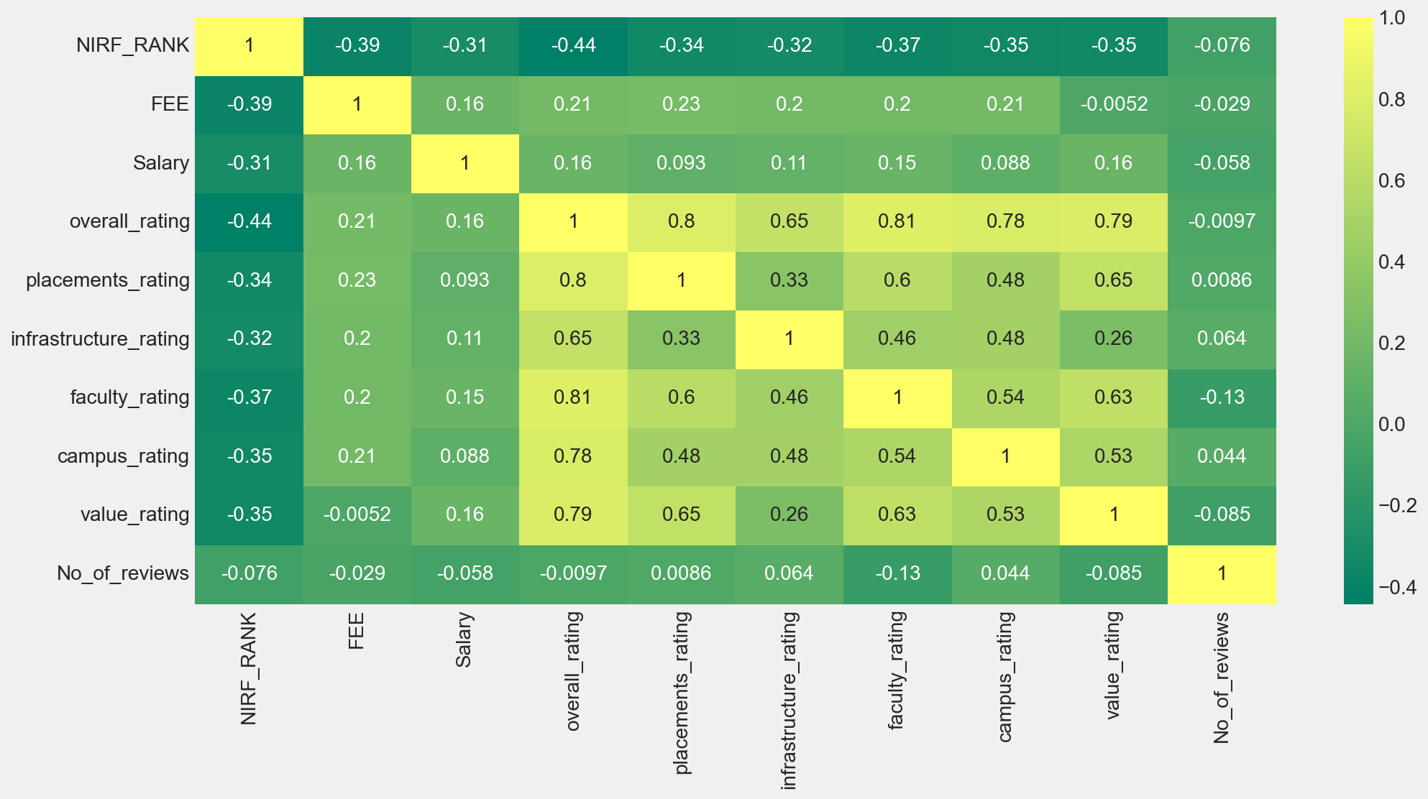
Multi-variate Analysis
Observation:
By above we have highly positive correlated values in Overall rating
We can observe that placements rating and faculty rating are affecting the overall rating more than others

Slide 18
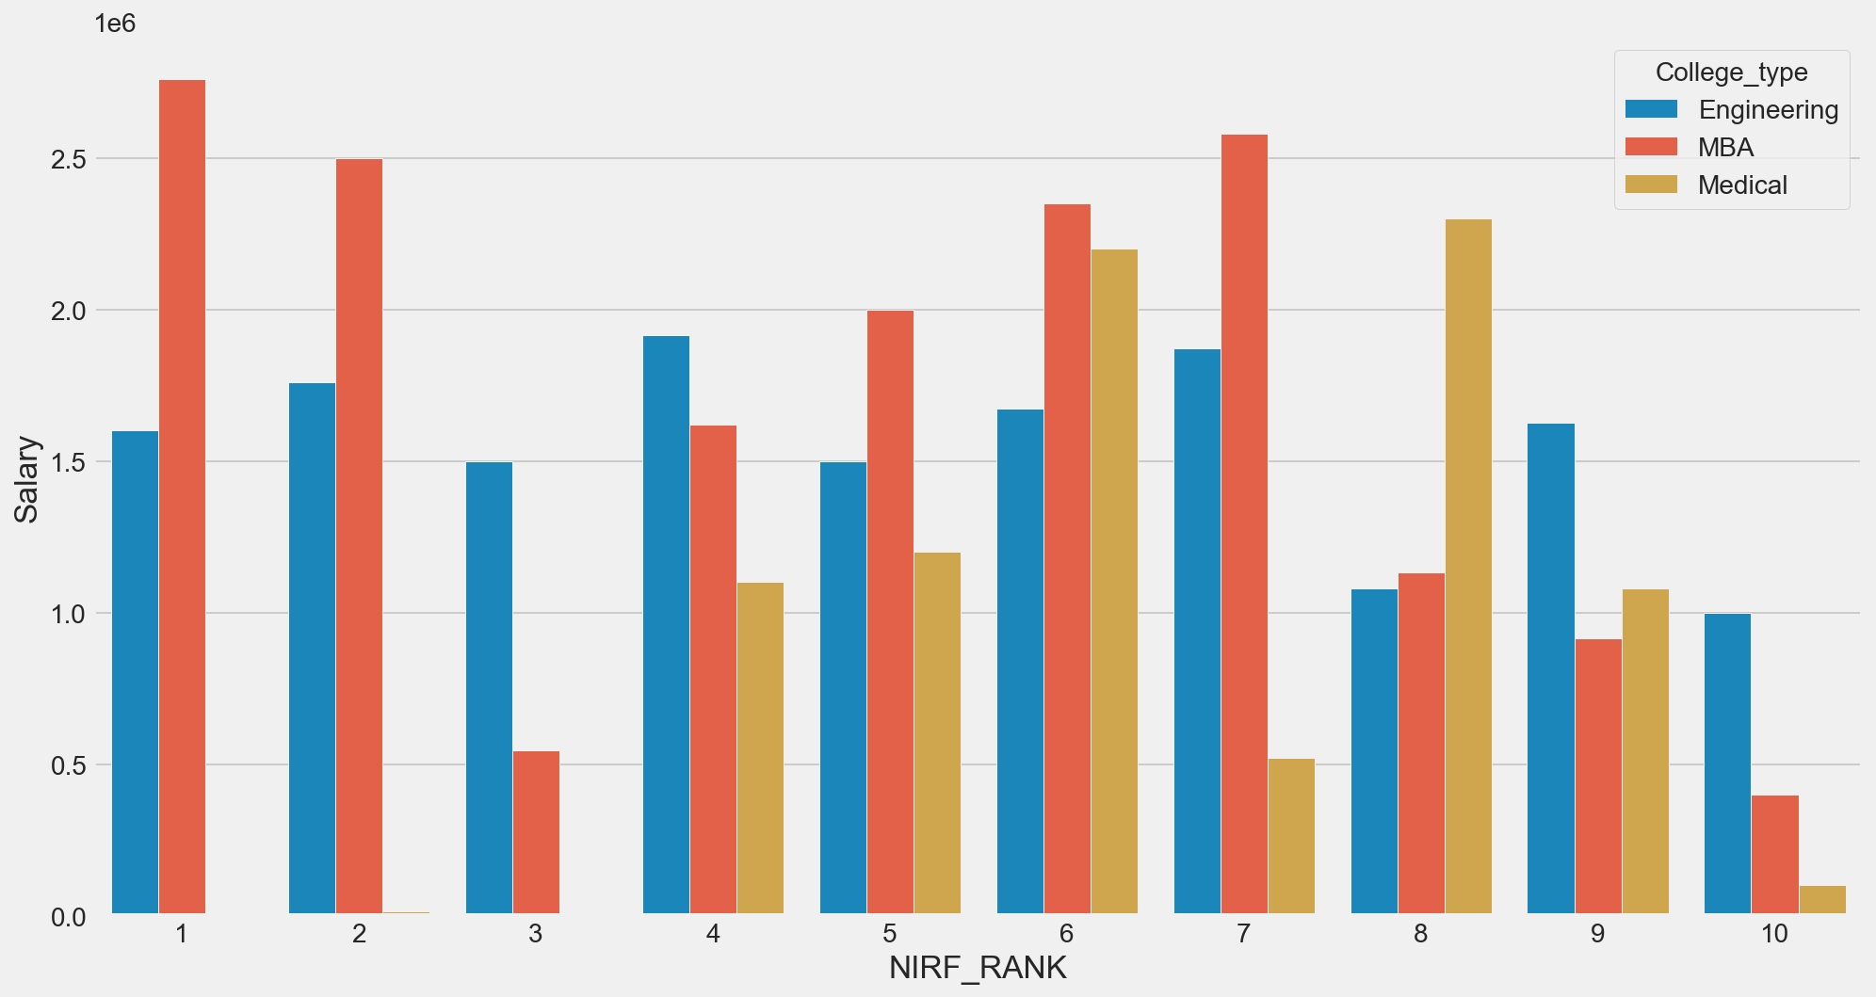
Observation:
The above graph describes us about salaries for top 10 NIRF ranking colleges in each college type
By observing we can say that rank no.4 college is offering high salaries Out of top 10 Engineering colleges,rank no.1 college is offering high salaries out of top 10 MBA colleges and rank no.6 college is offering high salaries out of top 10 Medical colleges

Slide 19
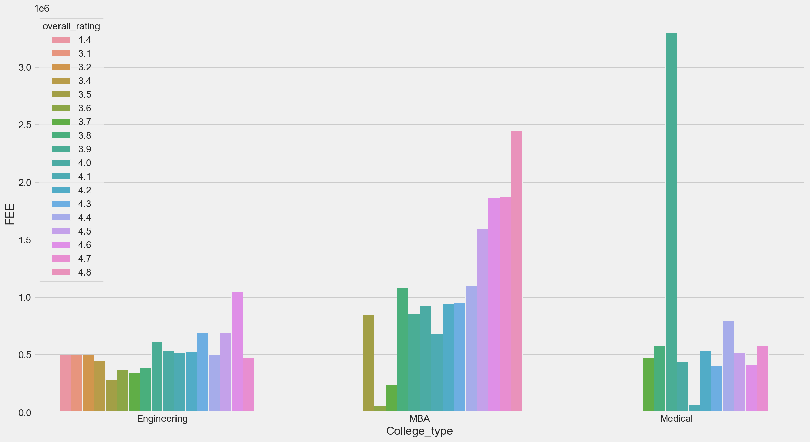
Observation:
By observing this we can say that Maximum number of engineering, MBA and Medical colleges falls under the 4.6 where fee are affordable, 4.8 where fee are high and 3.9 but the fee are extremely high for the students.

Slide 20
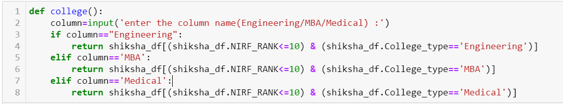
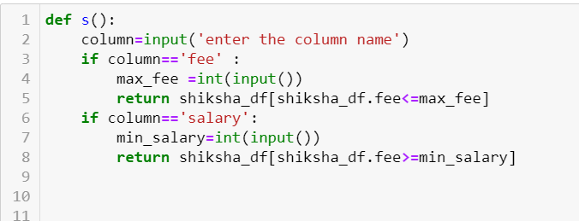
Functions for sorting the data
Function to find top 10 colleges in each stream
Function to find the required colleges based on fee and salaries

Slide 21
Conclusion
Our Data Frame is mainly useful for Engineering colleges.
MBA colleges are having high fee structure.
Medical colleges are giving high average salaries compared to other streams.
Top 10 colleges are based on Overall Rating.
We gains lot of knowledge by doing this project.

Slide 22
Experience on this Project
We found and tried different types of websites.
The Extraction of some websites required other libraries also.
We observed that there more to learn on going forward.
We have tried many techniques to scrape the data and the website pages like scrolling type and page numbered type.
We have also tried many visualization techniques for analysis.
We gain lots of knowledge by doing this project and other web scraping techniques.
We have tried plotly and these is another visualization techniques but struggled a lot.

Slide 23
Any Queries?

Slide 24
Thank you

